Slide 1


Amazon Sales Report
By: Shubham Ghosh & Vipin Bhagat

Slide 2
TABLE OF CONTENTS
Index No. | Title | Page No
1 | Introduction | 3
2 | Objective | 4
3 | Data Sharing Agreement | 5
4 | Data Description | 6
5 | Insights | 9
6 | KPIs | 10

Slide 3
INTRODUCTION
Amazon Sales data refers to sales, high performing sellers and several other data points.
There are millions of Amazon sellers around the world. Amazon sales data Analysis focuses on the process of analyzing consumer behavior, sales, and several other attributes in order to make improved, data-driven decisions. It is key to successfully sustaining their businesses and earning profits and for this purpose, they analyze different metrics like
Total Sales, Sales Quantity, Total Profit, Sales, Last Year Sales and other metrics. By analyzing these different metrics, we will be able to increase and improve our performance. It can also help us to better understand the market trends and customers’ buying behaviors
and help us to know what the customers really want.
3

Slide 4
OBJECTIVE
The objective of the project is to Analyse Amazon Sales data to get a substantial data
which will help in bringing changes in a business in the future. It will help to reveals
flaws in the business model or in the way that one is going about conducting business. Sellers will be able to clearly see where they’re losing money, what the problem is, and reduce their losses accordingly. It facilitates coming up with strategic solutions to problems. This project aims to provide visual understanding of the data using Microsoft Power Bi
Extract-Transform-Load Data
Visualize the gathered Insights
Get Insights

Slide 5
DATA SHARING AGGREMENT
File Name: Amazon Sales Data.csv
Dataset Size : 12.4KB
Number of Rows: 100
Number of columns: 14
5

Slide 6
DATA DESCRIPTION
ORDER ID
The ORDER ID is the ID given to the order.
1
2
ORDER DATE
The order date is the date when the product is ordered.
REGION
The region in which the customer stays.
3
COUNTRY
The Country in which the customer reside.
4
6

Slide 7
ITEM TYPE
Item type is the varieties of item sales in the Amazon.
5
6
SALES CHANNEL
Mode of shopping Online or Offline.
7
ORDER PRIORITY
Priority of Sales Range between low to high
8
SHIP DATE
Ship date when the product is dispatched.
UNIT SOLD
Number of unit sold per product.
9
7

Slide 8
UNIT PRICE
Selling Price of the product
10
11
UNIT COST
Cost of the Product.
TOTAL REVENUE
Total Sales of the Company.
12
13
TOTAL COST
Total Cost of the Company.
14
TOTAL PROFIT
Total Profit Earned by the Company.
8

Slide 9
INSIGHTS
1
KPIS
2
Profit Wise Analysis
3
Revenue wise Analysis
4
Cost wise Analysis
9

Slide 10
KPIS
44.17M
TOTAL PROFIT
137.35M
TOTAL REVENUE
93.18M
TOTAL COST
513K
UNIT SOLD
10

Slide 11

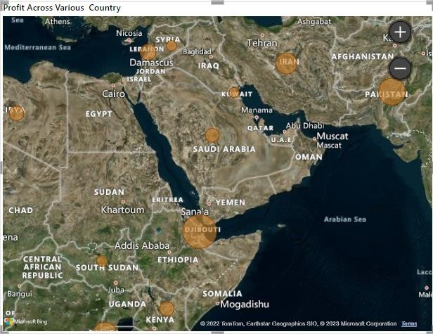
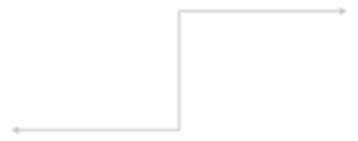

PROFIT WISE ANALYSIS
Profit Across Various Countries
KEY INSIGHTS
According to the visual the Profit is Highest in Djibouti and Least in Kuwait.
KUWAIT
TOTAL PROFIT- 1258(1.26K)
DJIBOUTI
TOTAL PROFIT-
2425318(2.43M)
11

Slide 12
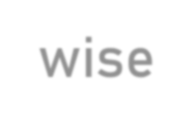
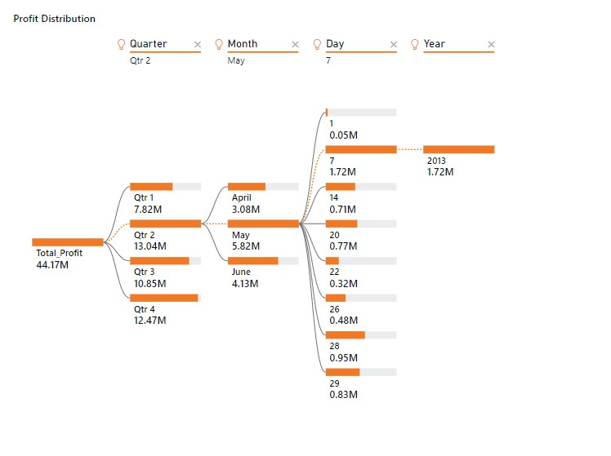
Profit Distribution Year,Month,Quarter and Day wise
KEY INSIGHTS
According to the visual Profit is Highest in Second Quarter in the month of may on day 7, in the year 2013 and Least in First Quarter.

Slide 13
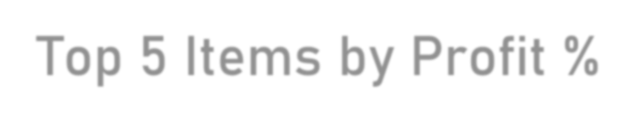
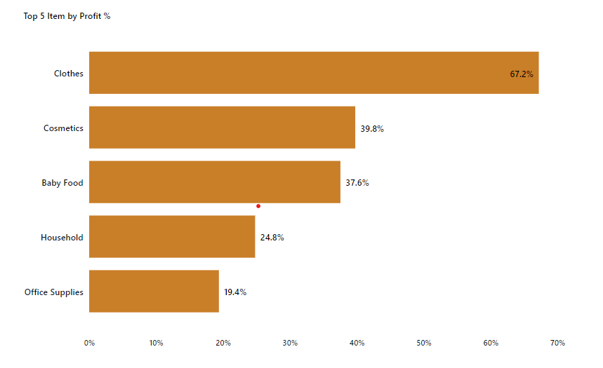
Top 5 Items by Profit %
KEY INSIGHTS
According to the visual we can see the Items which has highest Profit% which is Clothes having 67.2% and Office Supplies has Lowest Profit% having 19.4%.

Slide 14
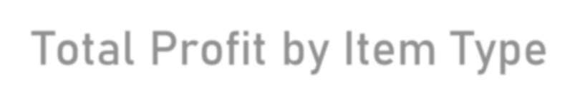
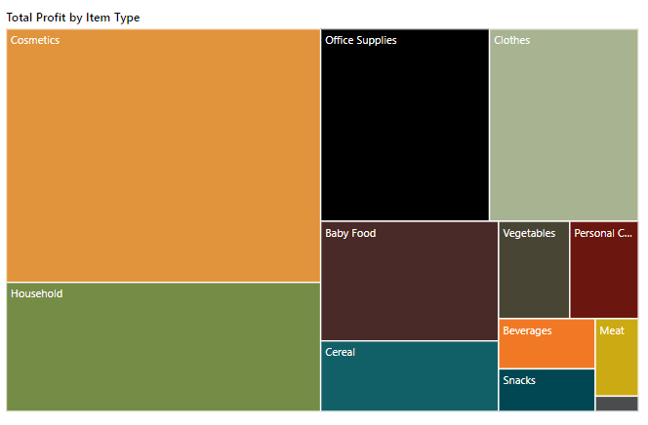
Total Profit by Item Type
COSMETICS
TOTAL PROFIT- 14.56M
KEY INSIGHTS
According to the visual we can see Clearly that the Cosmetics Item has Highest Total Profit where as Fruits has the Lowest
FRUITS
TOTAL PROFIT- 120.50K

Slide 15

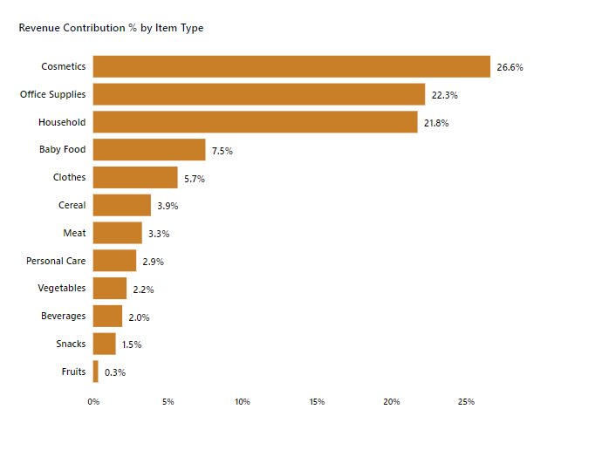
REVENUE WISE ANALYSIS
Revenue Contribution% by Item Type
KEY INSIGHTS
According to the visual we can see that the Cosmetics Item has the Highest Revenue Contribution
% where as Fruits has the
Lowest Revenue Contribution %

Slide 16
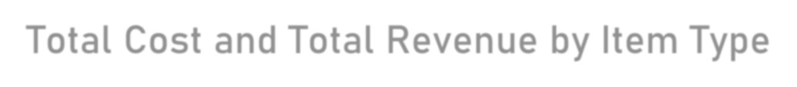
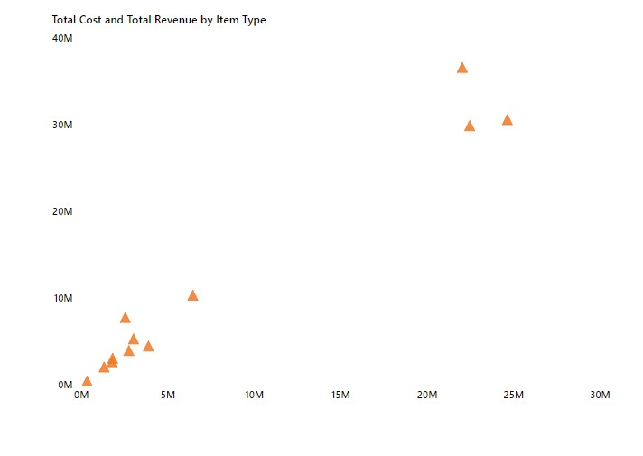
Total Cost and Total Revenue by Item Type
OFFICE SUPPLIES
TOTAL COST- 24.66M
KEY INSIGHTS
According to the visual we can see that the Office Supplies has the Highest Total Cost and Cosmetics has the Highest Total Revenue
COSMETICS
TOTAL REVENUE- 30.59M

Slide 17
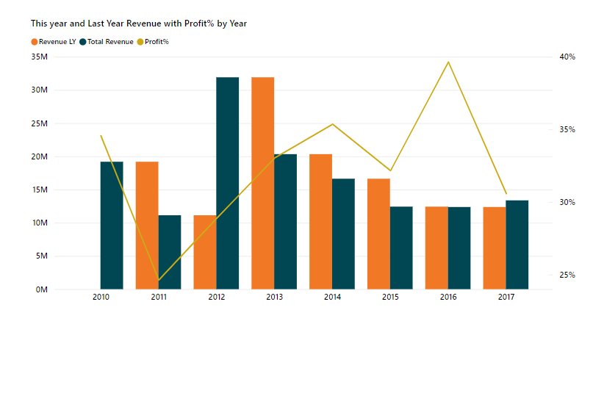
This Year and Last Year Revenue with Profit% by Year
KEY INSIGHTS
According to the visual we can
see that 2012 has the highest
Total
Revenue
whereas
with 28.9% of
2016 has the
Profit
highest Profit% which is 39.6%.

Slide 18

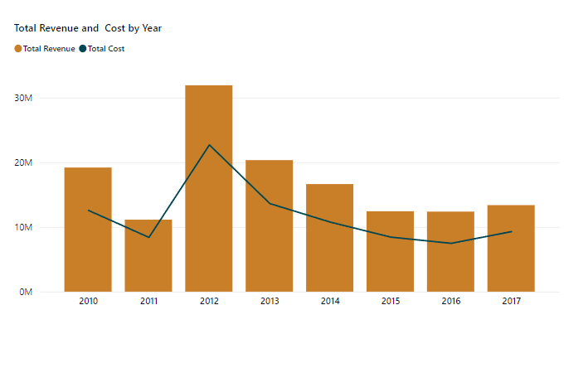
OVERALL ANALYSIS
Total Revenue and Cost by Year
KEY INSIGHTS
According to the visual we can see that 2012 has the highest Total Revenue of 31.90M and 2011 has the Lowest Total Revenue of 11.13M.
2012 has the highest Total Cost of 22.9M whereas 2016 has the lowest Total Cost of 39.6%.

Slide 19
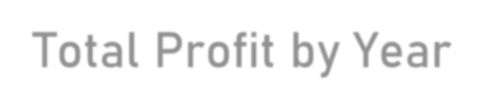
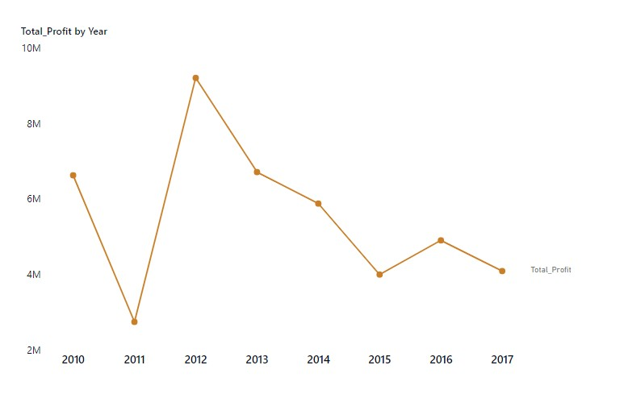
Total Profit by Year
KEY INSIGHTS
According to the visual we can see that 2012 has the highest Profit of 9.21M and 2011 has the Lowest Total Profit of 2.74M.

Slide 20

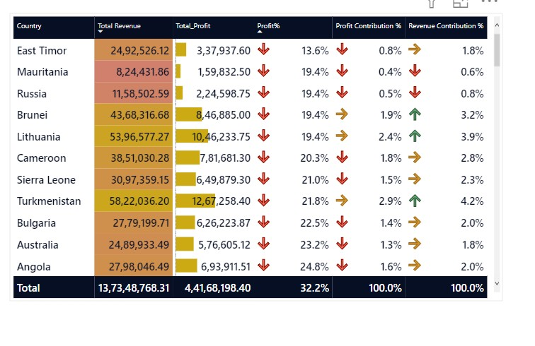
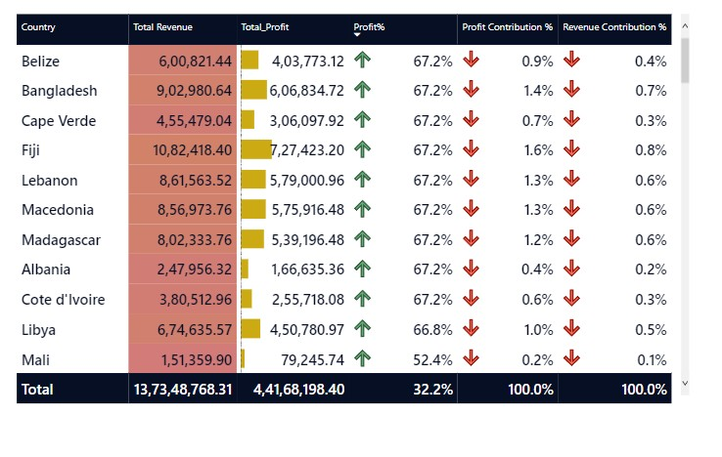
Table Metrics
KEY INSIGHTS
According to the Table we can see that From Belize Country to the Cote d’ivoire has the highest Profit% of 67.2% and East Timor Country has the Lowest Profit% of 13.6%.

Slide 21
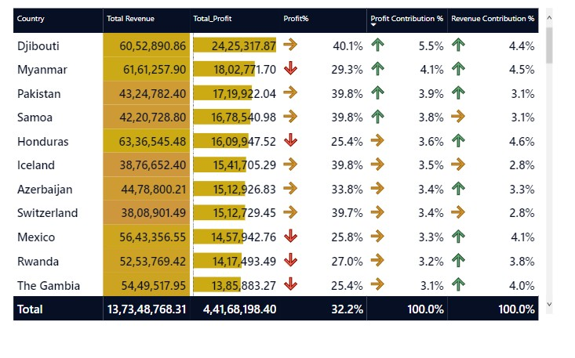
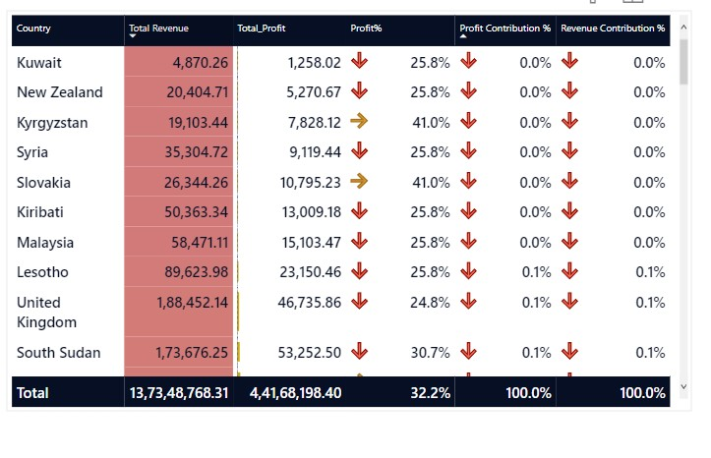
Table Metrics
KEY INSIGHTS
According to the Table we can see that Djibouti has the Highest Profit Contribution% of 5.5% .From Kuwait till Malaysia these Countries has Lowest Profit Contribution% of 0%.

Slide 22
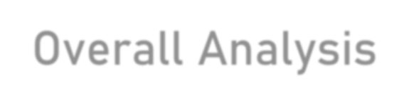
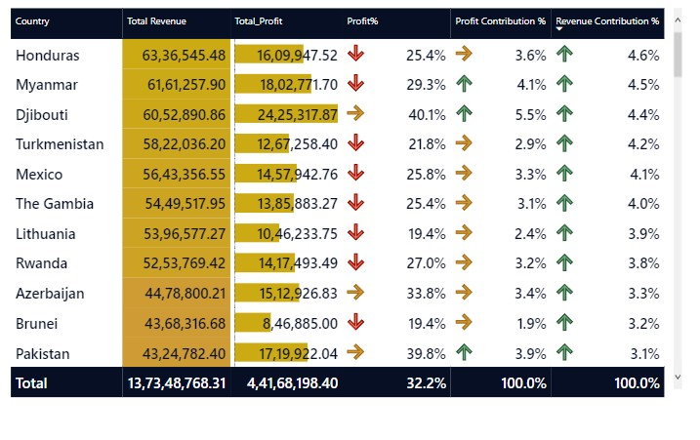
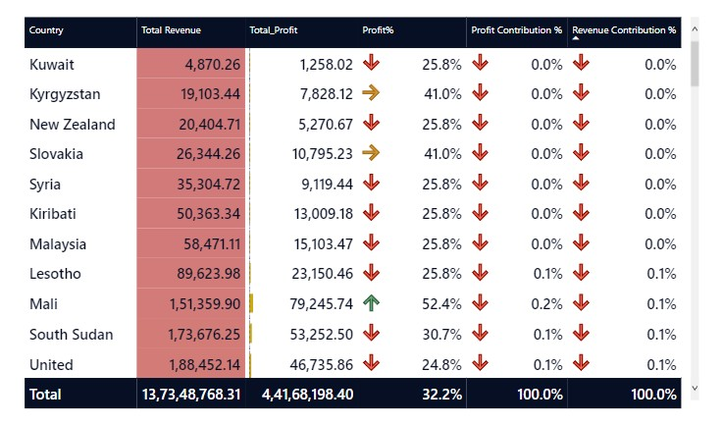
Overall Analysis
KEY INSIGHTS
According to the Table we can see that Honduras has the Highest Revenue Contribution% of 4.6% .From Kuwait till Malaysia these Countries has Lowest Revenue Contribution% of 0%.

